Slide 1


DR-VIDAL - Doubly Robust Variational Information theoretic Deep Adversarial Learning for Counterfactual Prediction and Treatment Effect Estimation
S90
Shantanu Ghosh,
University of Pittsburgh
Zheng Feng, Jiang Bian, Kevin Butler, Mattia Prosperi
University of Florida

Slide 2

Nancy is having fever
I am having a mild fever. Shall I take medicine or not?

Slide 3
Nancy is having fever
Features
I am having a mild fever. Shall I take medicine or not?
Age: 32
Sex: F
Blood group: A+
Race: Asian
Blood Sugar: High
Temperature: 100°F
….

Slide 4
Nancy is having fever
Features
I am having a mild fever. Shall I take medicine or not?
Age: 32
Sex: F
Blood group: A+
Race: Asian
Blood Sugar: High
Temperature: 100°F
….
Medication A
Control
T=0
Medication B
Treated
T=1
Temperature = ?
Temperature = ?

Slide 5
Nancy is having fever
Features
I am having a mild fever. Shall I take medicine or not?
Age: 32
Sex: F
Blood group: A+
Race: Asian
Blood Sugar: High
Temperature: 100°F
….
X
T
Y
Medication A
Control
T=0
Medication B
Treated
T=1
Temperature = ?
Temperature = ?

Slide 6
Nancy is having fever
Features
I am having a mild fever. Shall I take medicine or not?
Age: 32
Sex: F
Blood group: A+
Race: Asian
Blood Sugar: High
Temperature: 100°F
….
X
T
Y
Medication A
Control
T=0
Medication B
Treated
T=1
Temperature = ?
Temperature = ?

Slide 7
Fundamentally challenging problem
Features
I am having a mild fever. Shall I take medicine or not?
Age: 32
Sex: F
Blood group: A+
Race: Asian
Blood Sugar: High
Temperature: 100°F
….
X
T
Y
Medication A
Control
T=0
Medication B
Treated
T=1
Temperature = ?
Only one outcome is observed
Temperature = ?

Slide 8
Fundamentally challenging problem
Features
I am having a mild fever. Shall I take medicine or not?
Age: 32
Sex: F
Blood group: A+
Race: Asian
Blood Sugar: High
Temperature: 100°F
….
X
T
Y
Medication A
Control
T=0
Medication B
Treated
T=1
Counterfactual
Factual
Temperature = ?
Only one outcome is observed
Temperature = ?

Slide 9
Causal Inference is challenging due to counterfactuals
Solutions
Randomized control trail
Propensity score matching
Inverse probability weighting
Sibbald et al. [BMJ, 1998]
Tian et al.[2018]
Austin et al. [2011]

Slide 10
Causal Inference is challenging due to counterfactuals
Solutions
Drawbacks
Randomized control trail
Propensity score matching
Inverse probability weighting
Unethical, not feasible
Rest are mostly linear
Sibbald et al. [BMJ, 1998]
Tian et al.[2018]
Austin et al. [2011]

Slide 11
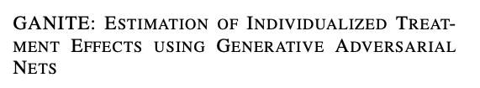
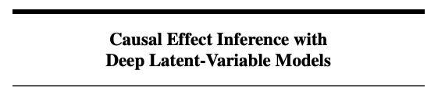
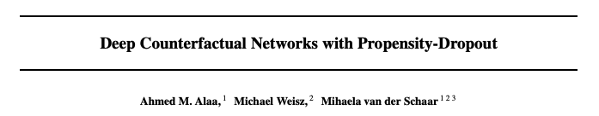
Causal Inference is challenging due to counterfactuals
Solutions
Drawbacks
Randomized control trail
Propensity score matching
Inverse probability weighting
Unethical, not feasible
Rest are mostly linear
Growth in deep learning
Sibbald et al. [BMJ, 1998]
Tian et al.[2018]
Austin et al. [2011]

Slide 12
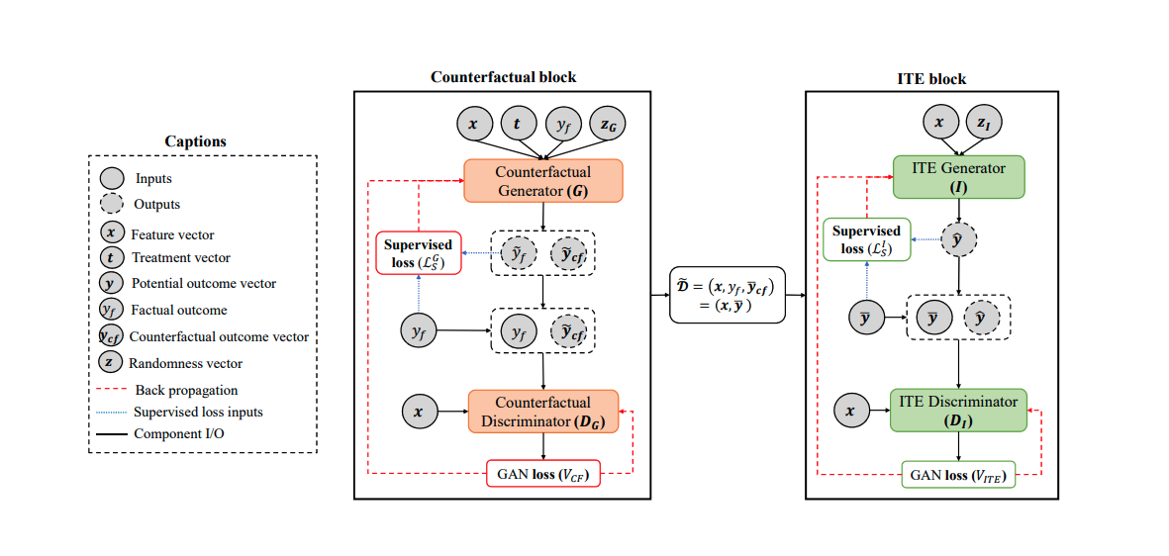
Estimation of counterfactuals using deep learning
Yoon et al. [ICLR, 2018]

Slide 13
Prior research motivates to use latent encoding than data
Dumoulin et al. [ICLR, 2017]
Yu et al.[ICJAI, 2019]

Slide 14
Our contribution
Incorporate of an underlying causal structure to approximate the data generation
process.
2. Infer the latent variables, responsible for generating data using a VAE.
Generate counterfactual outcomes using a GAN with variational information
theoretic regularization.
Estimate the individual treatment effect by minimizing the factual and
counterfactual outcomes both.
5. Utilize doubly robust regularizer for faster convergence.

Slide 15
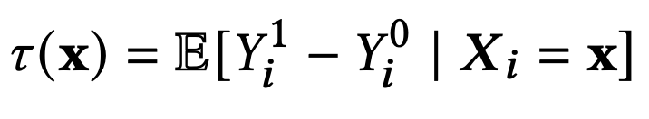
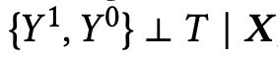
Problem formulation
Used potential outcome framework by Rubin.
The complete tuple {X_{i}, T_{i}, Y_{i} }, for i=1...N
Y_{i}⁰ and Y_{i}¹ are the potential outcomes for treatment T_{i}=0 and T_{i}=1
The ITE for the subject i with covariates X_{i} = x is defined as,
Assumption:
Followed strongly ignorable treatment assignment assumption (SITA), defined as,

Slide 16
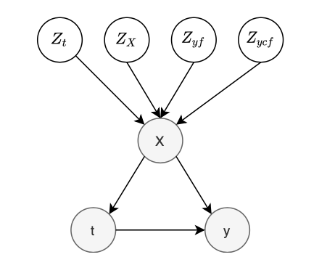
Contribution #1: Causal structure
Z: Latent space
X: Observed covariates
t: Treatment indicator
Y: Potential outcome

Slide 17
Contribution #2: Infer the latent variables
Back Propagation
Forward Propagation

Slide 18
Contribution #2: Infer the latent variables
All the latent factors - z, are assumed to have a prior gaussian distributions defined as,
Back Propagation
Forward Propagation

Slide 19
Contribution #2: Infer the latent variables
All the latent factors - z, are assumed to have a prior gaussian distributions defined as,
The variational posteriors of the inference model is defined as,
Back Propagation
Forward Propagation

Slide 20
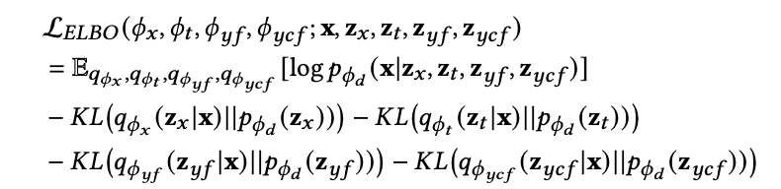
Contribution #2: Infer the latent variables
All the latent factors - z, are assumed to have a prior gaussian distributions defined as,
The variational posteriors of the inference model is defined as,
The overall ELBO function to optimize
Back Propagation
Forward Propagation
https://github.com/Shantanu48114860/DR-VIDAL-AMIA-22/blob/main/DR_VIDAL_AMIA-Supp.pdf

Slide 21
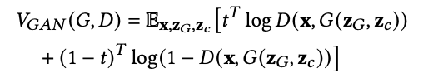
Contribution #3: Generate counterfactuals
Following GANITE, the optimization function of the GAN block,
Back Propagation
Forward Propagation

Slide 22
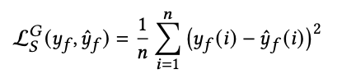
Contribution #3: Generate counterfactuals
Following GANITE, the optimization function of the GAN block,
The supervised loss is defined as,
Back Propagation
Forward Propagation

Slide 23
Contribution #3: Generate counterfactuals
Following GANITE, the optimization function of the GAN block,
The supervised loss is defined as,
The complete loss of the counterfactual GAN block is defined as,
Back Propagation
Forward Propagation

Slide 24
Contribution #3: Generate counterfactuals
Following GANITE, the optimization function of the GAN block,
The supervised loss is defined as,
The complete loss of the counterfactual GAN block is defined as,
Maximize I(z_{c}; G(z_{G}, z_{c})) to solve the optimization function
Back Propagation
Forward Propagation
Notes:
the mutual information between the learned concatenated latent code z_{c} and the generated output by the generator G(z_{G}, z_{c})

Slide 25
Contribution #3: Generate counterfactuals
I(z_{c}; G(z_{G}, z_{c})) is harder to optimize due to p(z_{c}|x), so using a variational distribution Q(z_{c}|x) to approximate the posterior p(z_{c}|x).
The optimal discriminator and generator will be obtained by solving the following objectives
Back Propagation
Forward Propagation
Notes:
the mutual information between the learned concatenated latent code z_{c} and the generated output by the generator G(z_{G}, z_{c})

Slide 26
Contribution #4: Estimate ITE by minimizing the factuals and counterfactuals

Slide 27
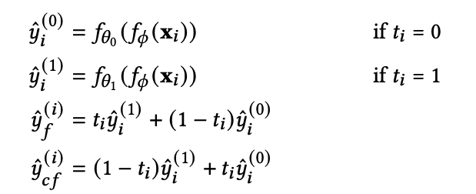
Contribution #4: Estimate ITE by minimizing the factuals and counterfactuals
The factual and the counterfactual outcomes were estimated as,

Slide 28
Contribution #4: Estimate ITE by minimizing the factuals and counterfactuals
The factual and the counterfactual outcomes were estimated as,

Slide 29
Contribution #5: Doubly robust ITE Estimation
Using propensity score, the doubly robust estimation of causal effect is defined as,
where,
Jonsson et al. [American Journal of epidemiology, 2011]

Slide 30
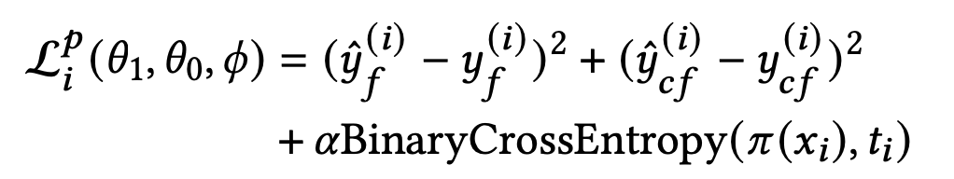
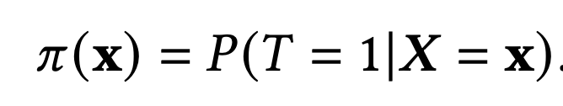
Contribution #5: Doubly robust ITE Estimation
Using propensity score, the doubly robust estimation of causal effect is defined as,
where,
The predicted loss to be optimized as,
The propensity score is defined as,
Jonsson et al. [American Journal of epidemiology, 2011]

Slide 31
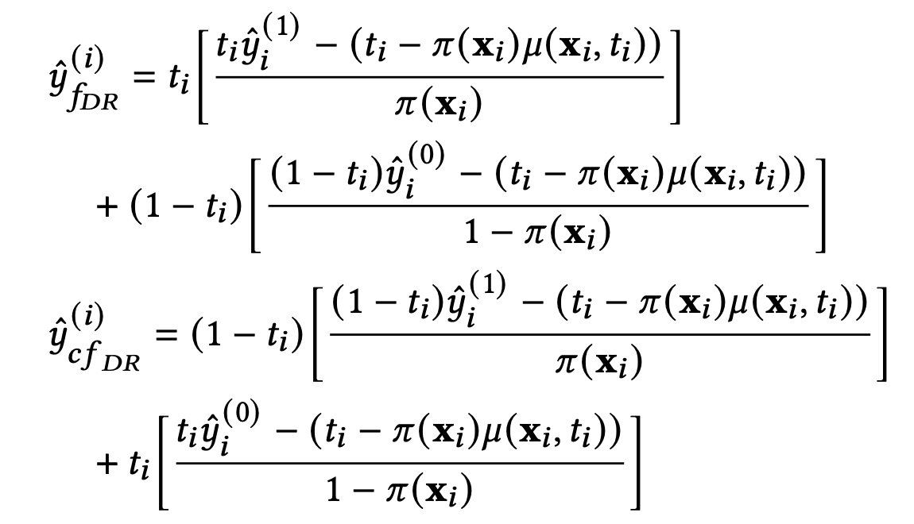
Contribution #5: Doubly robust ITE Estimation
The factual and the counterfactual doubly robust outcomes were estimated as,
Jonsson et al. [American Journal of epidemiology, 2011]

Slide 32
Contribution #5: Doubly robust ITE Estimation
The factual and the counterfactual doubly robust outcomes were estimated as,
The doubly robust loss is optimized as ,
Jonsson et al. [American Journal of epidemiology, 2011]

Slide 33
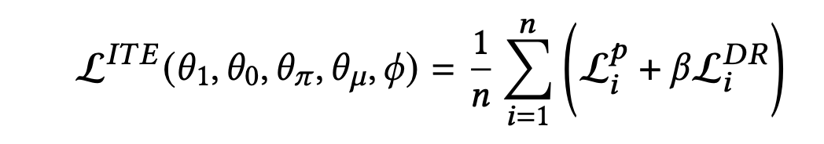
Contribution #5: Doubly robust ITE Estimation
The factual and the counterfactual doubly robust outcomes were estimated as,
The complete loss to estimate ITE to be optimized as,
The doubly robust loss is optimized as ,
Jonsson et al. [American Journal of epidemiology, 2011]

Slide 34
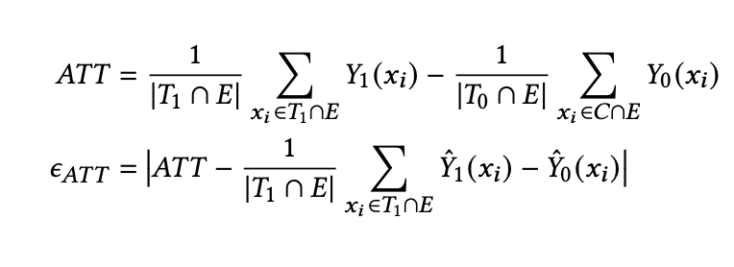
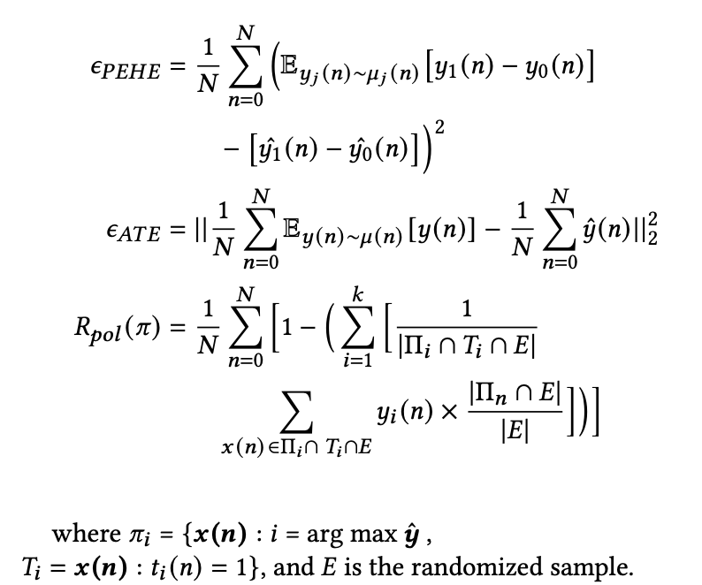
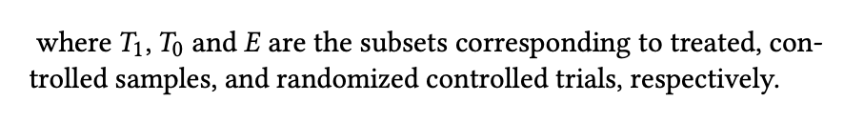
Performance metrics

Slide 35
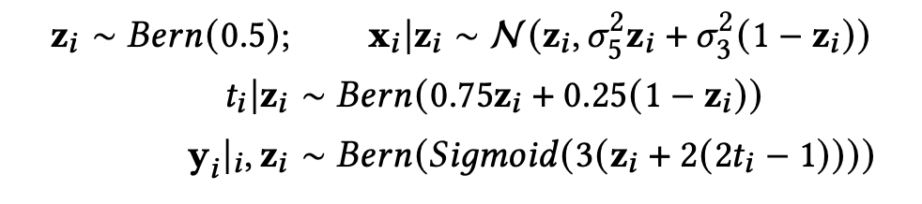
Performance – Synthetic datasets 1
Comparison of the performance (ATE) of DR- VIDAL vs. all other models on samples from the generative process of Synthetic dataset 1 - sample size {1000, 3000, 5000, 10000, 30000}
Louizos et al. [Neurips, 2017]

Slide 36
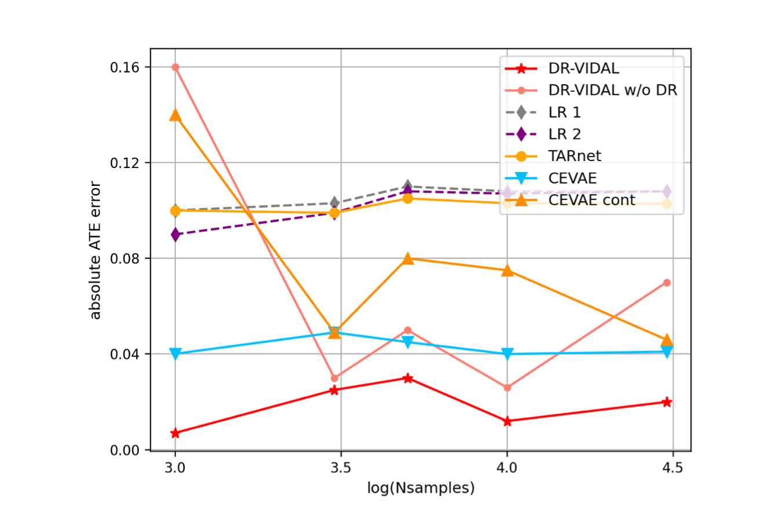
Performance – Synthetic datasets 1
Comparison of the performance (ATE) of DR- VIDAL vs. all other models on samples from the generative process of Synthetic dataset 1 - sample size {1000, 3000, 5000, 10000, 30000}
Louizos et al. [Neurips, 2017]

Slide 37
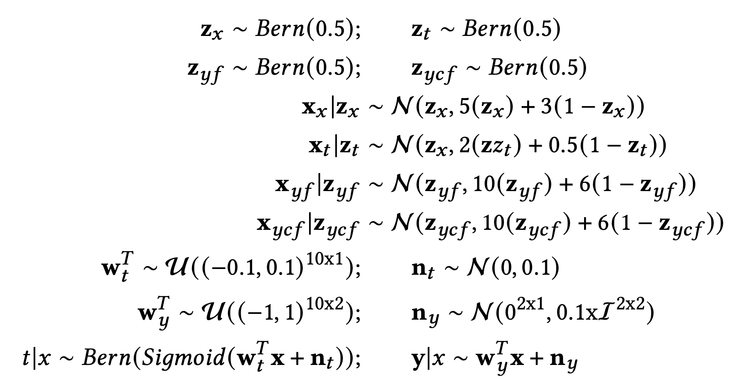
Performance – Synthetic datasets 2
Performance comparison (PEHE) of GANITE vs. DR-VIDAL

Slide 38
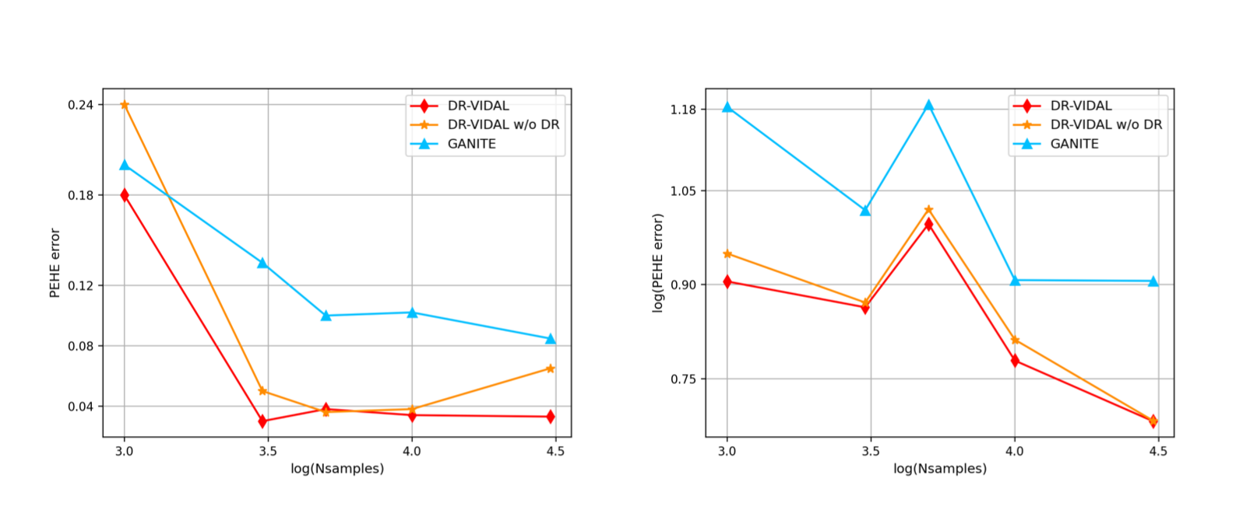
Performance – Synthetic datasets 2
Performance comparison (PEHE) of GANITE vs. DR-VIDAL

Slide 39
Performance – Real world datasets
IHDP
Jobs
Twins

Slide 40
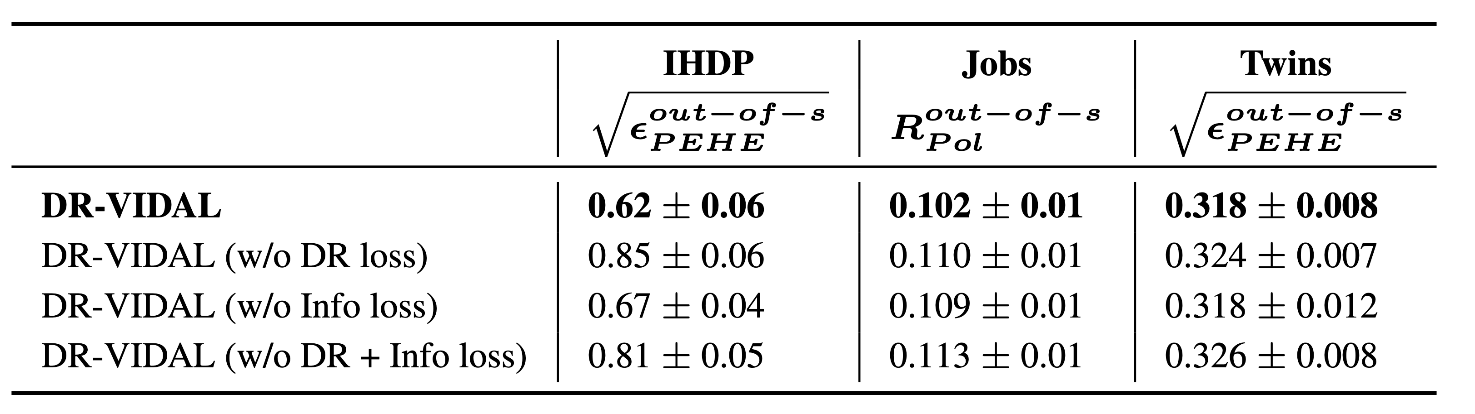
Performance – Ablation study

Slide 41
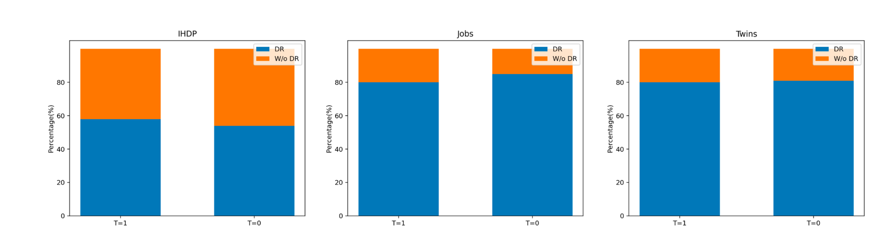
Performance – correct classification of factual outcomes

Slide 42
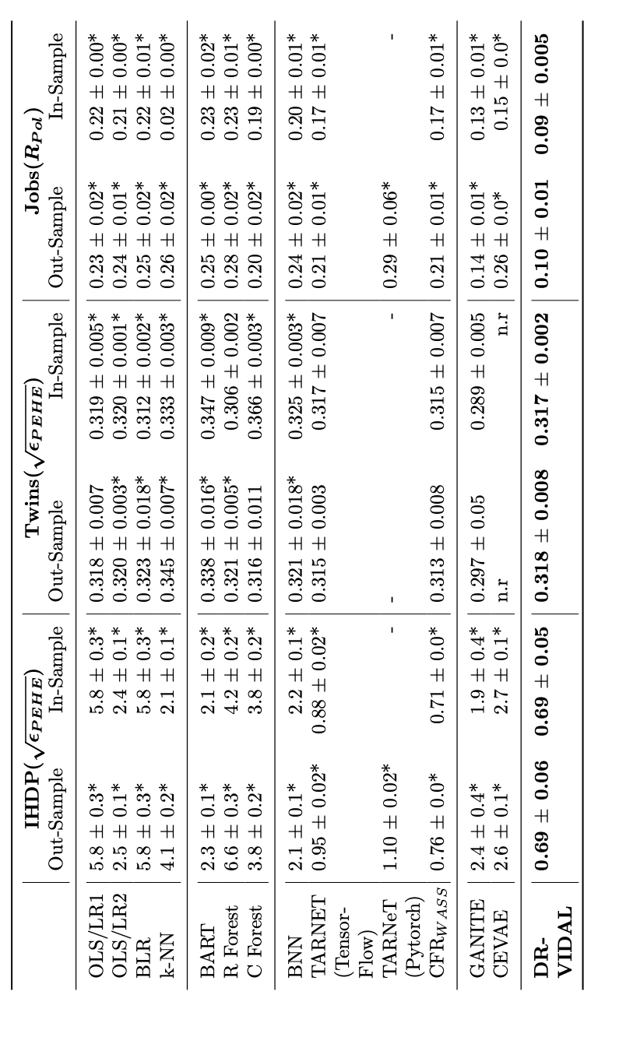
Performance – PEHE and policy risk (mean ± st.dev)

Slide 43
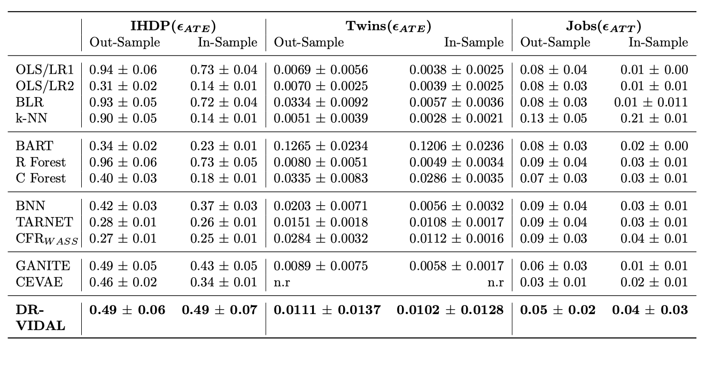
Performance – ATE and ATT (mean ± st.dev)

Slide 44
Conclusion
Beats the performance of previous generative models on synthetic datasets
Comparable performance on real-world datasets.
Code: https://github.com/Shantanu48114860/DR-VIDAL-AMIA-22/

Slide 45
Future directions
1. Causal Graph is too simple.
2. How to enforce strict disentanglement?
3. Instead of Variational Information Maximization, what about Variational Information Bottleneck Layer?
4. TARNET, DRAGONNET, DCN-PD, ITE block as a downstream model instead of the Doubly robust treatment estimator.
6. More realistic data from News-8 or MIMIC-II(EBB).

Slide 46

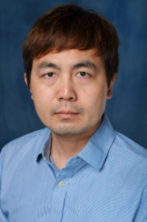

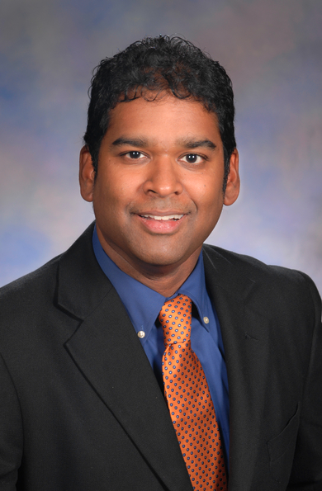
Acknowledgement

Slide 47
Thank you!
Email me at: shg121@pitt.edu

